Slide 1
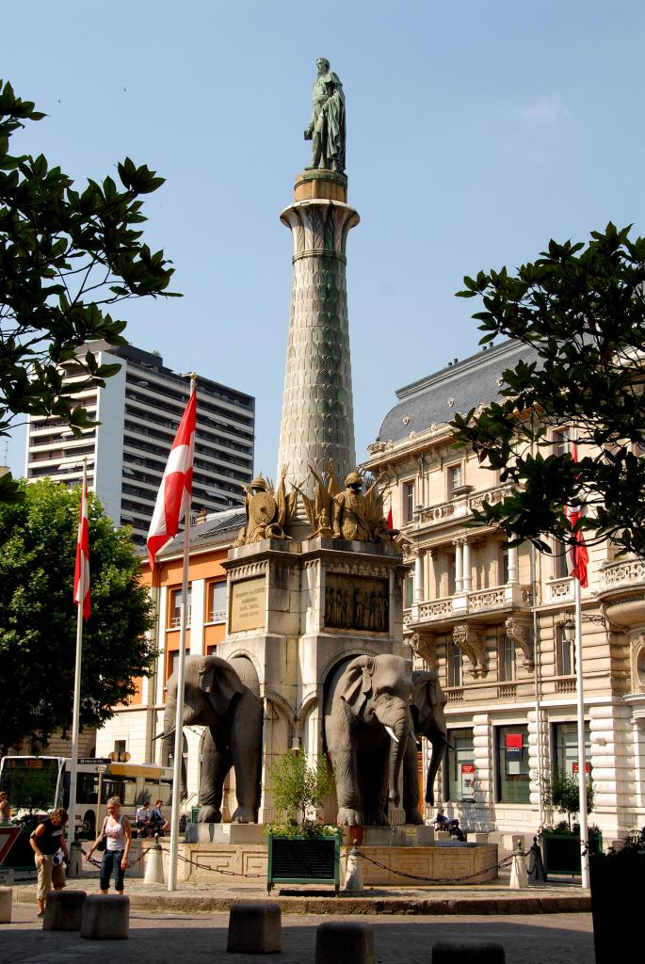
Visuel de l’événement
Master Tourisme
I.T.M.
International
Tourism
Management
Semester 10
for incoming students
Center for International Tourism
Hospitality and Events Management
C.I.T.H.E.M.E.
www.iae.univ-smb.fr

Slide 2
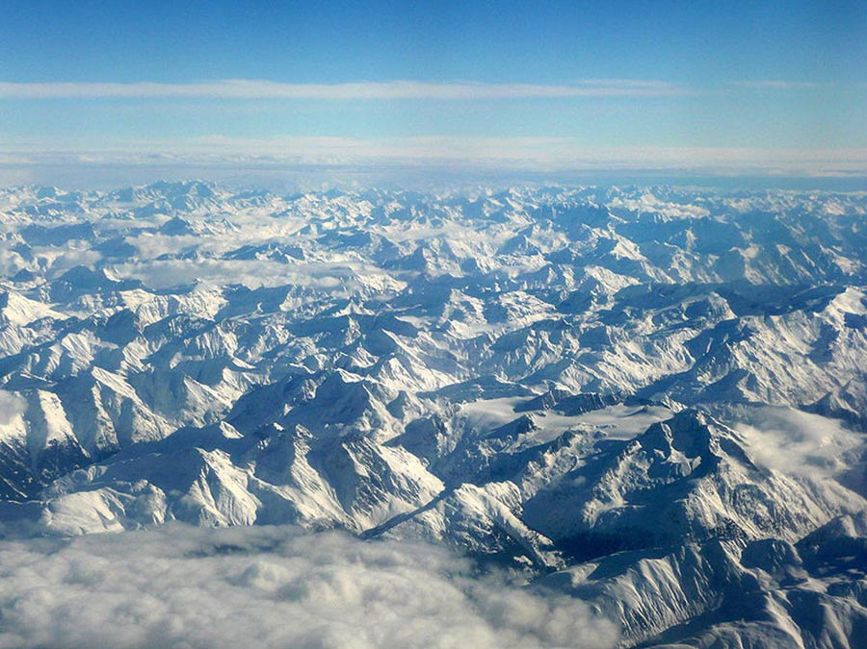
Why choose ITM at Université Savoie Mont Blanc?
Study in English & improve your French
Full semester workload of our Tourism Management master’s degree taught in English / Double diploma possibilities / Up-to- the-minute mix of specialist lectures, interactive seminars and case-studies / real-life projects for major tourism operators.
« A-rated » teaching & content
Highly ranked university and city / Team of teachers with a valuable balance between academics and representatives from the professional world, applying management and marketing concepts and practice to Tourism, with particular attention to innovation and recent evolution.
Quality accommodation & activities
The university's housing office provides help in securing accommodation, either in private lodgings or student residences, the latter generally taking the form of an individual private study-bedroom in an apartment sharing kitchen & bathroom with one other student. Located between the campus & the city center, both are easily reached on foot or in a few minutes by bus.
Gateway to the French Alps & lakes: total student experience
Our international office & student associations provide exciting excursion, sports and leisure programs enabling foreign and local students to take every advantage of the extraordinary opportunities offered by our historical and natural background and surroundings. Theater, art, history, architecture, indoor & outdoor shows, concerts & events, cycling for leisure or sport, vineyard & cheese trails, and of course just about every water, countryside or mountain sport.

Slide 3
ITM : a Master’s degree in Management
I.T.M. graduates become:
Tourism business opportunities assessment consultants
Public private partnership program managers
Worldwide & multicultural team leaders
Travel & trade development
/ marketing managers
Strategic membership partnership & alliance office managers
International meetings, incentives, conferences & exhibition coordinators
Cross border tourism project managers
Heads of travel innovation, R&D
With the ITM transformative experience, high-flyers develop their management competences, soft skills and agility, to become tomorrow’s top tourism managers. ITM students:
Acquire full comprehension and command of what is at stake in both the Public sector and Private businesses to form efficient Partnerships in tourism.
Develop themselves, develop their own work methodology and think adaptively to reach expertise, experience and exceed their own expectations.
Bloom internationally, appreciate cultural differences so as to comprehend the lastest trends and turn the multicultural challenges of an ambiguous and volatile environment into opportunities.
Meet and join the industry on real consulting projects and missions, network efficiently to eventually thrive in the world of tourism on rewarding positions with high responsibilities.

Slide 4
Key features of the ITM curriculum
« I.T.Master’s students benefit from both academic excellence and professional partners;
The course leader is an associate professor with extensive professional network in the tourism sector.
The programme was designed to develop an array of skills that are critical for employability and success in international business and tourism.»
Hard and soft skills
The programme is based on an inclusive approach to three main sets of skills:
Management,
Tourism expertise,
Linguistic and intercultural ablities
(French + English + German / Italian / Spanish)
Intercultural & international
ITM students may choose from 40 partners universities in over 20 countries (semesters 7 or 8), and will study abroad at one of the ITM-Network partner universities during semester 9, develop their collaborative intelligence in international groups, with semesters 9 and 10 taught in English.
Learning by doing
Key players from the tourism industry provide the students with hands-on experience in managerial issues. Business games, real cases, consulting missions, problem-solving approach… are at the core of the ITM transformative experience.
Claire Salmon
Directrice IAE
Savoie Mont Blanc

Slide 5
Skills | Semestre 10 / 30 ECTS
Managerial | Doing business in a disrupted world : Business model canvas | 3
 | Consumer trend’s intelligence | 3
Professional | Internship and academic report | 6
International | English project for “Doing business in a disrupted world” | 3
 | Projet Allemand, Espagnol, Italie, FLE TDMM | 2
Expertise | Consolidate your Sales Force with optimization techniques | 4
 | Marketing strategy for Catering Business | 5
 | ITMN online management game | 2
 | Event management concepts | 2
Master 2 Tourisme
Semester programme

Slide 6
ITM : Master programme
Master 2 Semestre 10
Consumer
Trends’ intelligence
Doing business in a dirupted world : Business model canvas
The objective of this lecture is to investigate the current consumer trends that will impact and shape consumption trends in years to come.
The lecture will dig into the sociological and psychological dimensions of current trends, so as to understand the key foundations of consumer trends.
In-depth understanding of consumers is essential to produce efficient marketing strategies.
.
This lecture, and its focus on applications, will enable you to:
Discover how the digital economy acts as a catalyst at the core of business transformation
Master main disintermediation phenomena to get a clear vision of business threats and opportunities
Get strong skills on leading/coordinating innovative and coherent digital strategy for both traditional and pure players
Lead a complete business digital model mission for a real company.
This course is linked with the English project research.
3 ECTS / 20h Class contact
3 ECTS / 20h Class contact

Slide 7
ITM : Master programme
Master 2 Sem. 10
Consolidate your Sales Force with optimization techniques
Event Management Concepts
Revenue Management skills are central for future top managers willing to manage commercial teams and profitable businesses. In this immersive course, students will:
Improve their holistic vision of the tourism industry by integrating RM knowledge
Discover the major mechanisms of RM and learn how to disseminate them to employees
Strengthen the quality of Sales Force in their selling process by integrating RM indicators to optimize competitive performance
Improve their numerical, analytical and logical skills
This course explores the principles and practices of managing medium- and large-scale events including festivals, conventions, concerts, shows, sporting events, and ceremonies. It emphasizes strategic event design, organization and planning communications, personnel, and security as well as evaluation and innovation.
2 ECTS / 10h Class contact
ITMN online management game
A contest for student teams from various universities in the world. In essence, the participants will be divided into groups to run their respective tourism “companies” and compete for resources as well as customers in the same market.
The groups are required to demonstrate hands-on experience and work on challenges based on real-life scenarios, making business decisions (finance, marketing, HRM, CRM, strategic planning…) as well as translating them into quantitative terms in order to deliver business results.
4 ECTS / 30h Class contact
2 ECTS / 12h Class contact
2 ECTS / 12h Class contact

Slide 8
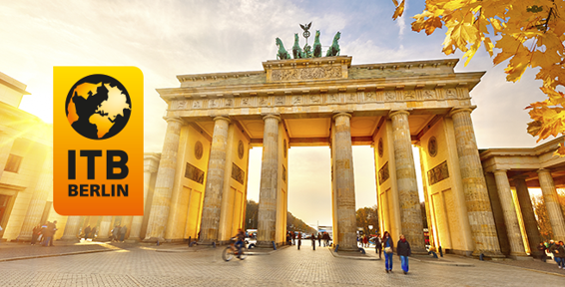
ITM : Master programme
Master 2 Sem. 10
Marketing Strategy for Catering Business
Students will have to carry out a business mission in partnership with Mme Vacances, the French leader in hospitality & resort accommodation.
In this project-based course, Students will:
Get an overview of the catering industry, which is a key sector in the tourism dynamics
Choose and work on a specific project in this field and search for relevant information
Develop their research, analytical and business-oriented skills to define strategic and marketing perspectives
Defend a value proposal as future professionals worldwide (history, brands, activities, labels, etc.)
ITB Berlin : The World’s Leading Travel Trade Show
ITM students participate in ITB Berlin, the world’s leading travel trade show and exhibition to :
Attend high level and exclusive lectures and conferences from decision makers, industry experts and buyers
Enrich and consolidate their academic reports and semester projects
Develop their professional network and identify training and job opportunities by meeting top managers
5 ECTS / 40h Class contact

Slide 9
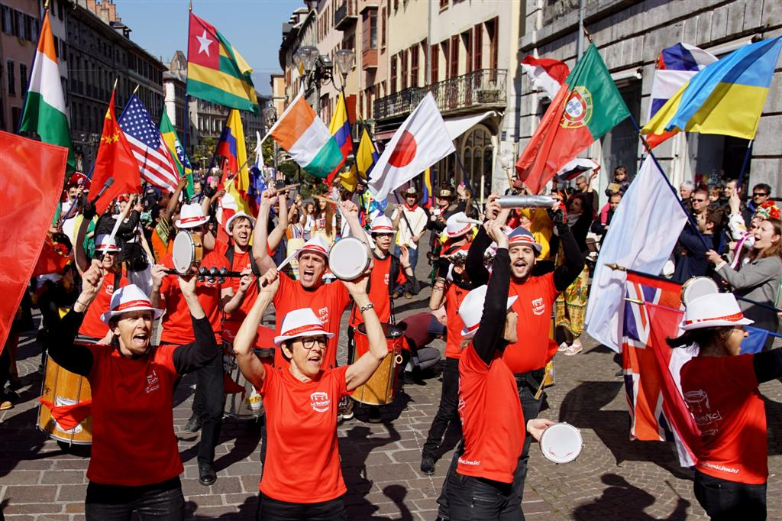
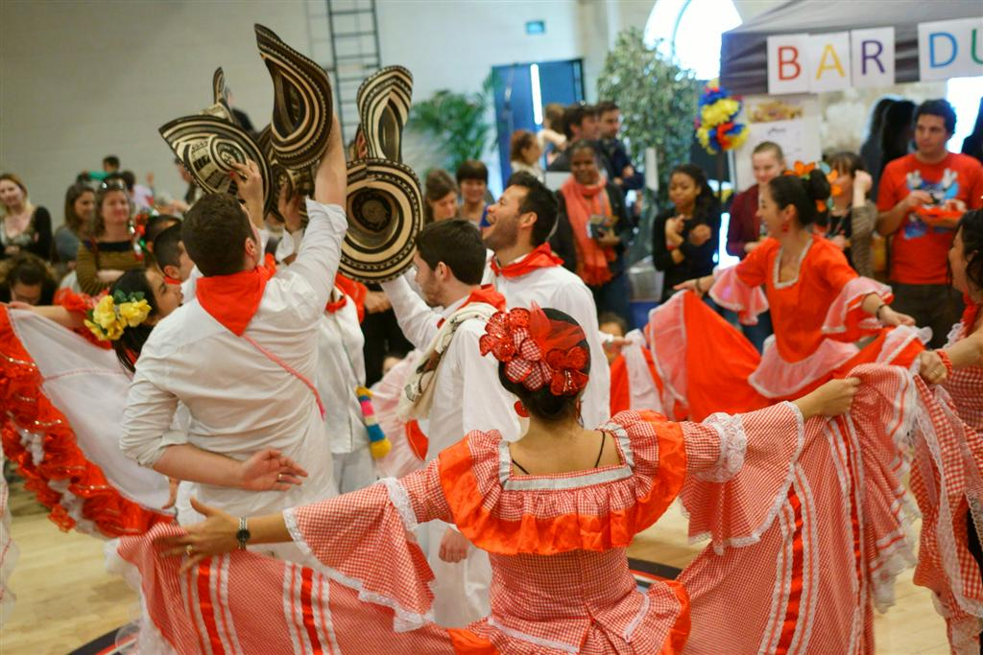
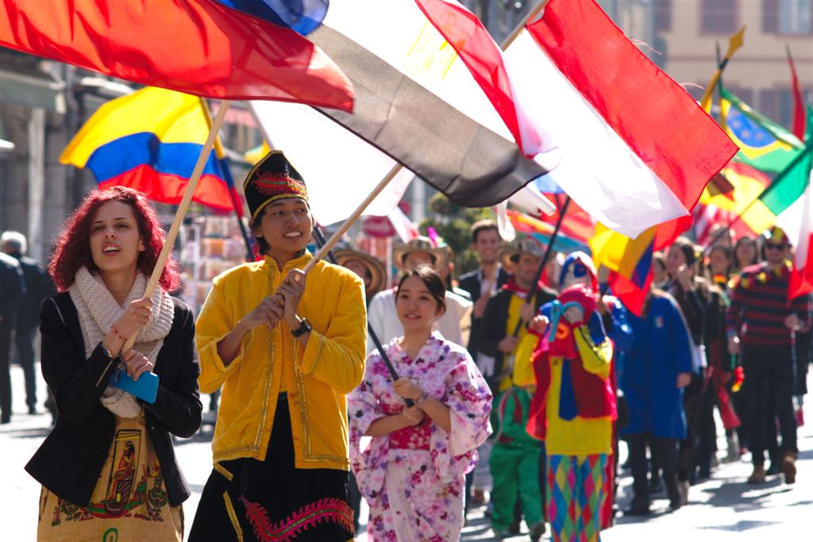
ITM : Master programme
Master 2 Sem. 10
French F.L. / Event Management Project :
« Tour du Monde au Manège » International Fair
Incoming students only
The students will be responsible for their national stand during the “Tour du Monde au Manège” event. This 2-day fair is organized every year for the general public by the City of Chambery with Universite Savoie Mont Blanc Events Management students, together with International students and associations. More than 4,000 visitors visit the “international village” exhibition and attend the conferences on tourism destinations and experiences.
The international students prepare a creative stand with a limited budget, help organize the event, meet the French visitors’ expectations.
They have to write an analytical report about their experience and the skills needed to manage events:
Recognize the significance of diversity issues in planning and managing events.
Develop an ability to solve problems in an ever changing operational environment.
Develop effective intercultural communication skills.
Plan and manage their own time to achieve a specific objective.
Develop an ability to work as part of a team.
2 ECTS - http://tourdumonde-chambery.com/
.

Slide 10
ITM : Master programme
Master 2 Sem. 10
Business Internship, academic report
& professional skill defense
Savoie and Double-degree students only
The internship must last 5 months; it takes place between mid -April and the end of September.
The missions of the internship must be related to the student’s expertise (in the tourism field) and correspond to Master’s level, that is to say should include high responsibilities.
Students will have to write an academic dissertation (mémoire) in English with the academic research methodology (research question, literary review and original primary sources)
6 ECTS / Internship and academic report
Double-degree students must complete this module to graduate with USMB Master’s degree
Incoming students may replace the summer internship with
« French as a Foreign Language » and « French Culture » courses to complete the 30 EC-semester

Slide 11
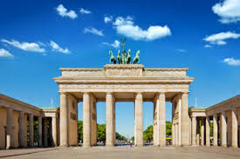
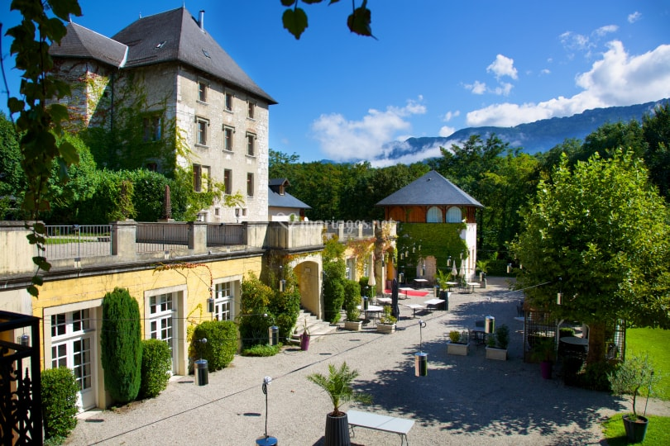
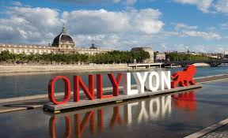
Academic calendar
From mid January (week 3) to mid April (week 15)
Week 3: ITM Induction days
Week 4: Regular classes start
Week 9: Tour du Monde au Manège International Fair
Week 10: ITB Berlin
Week 12: Study week
Week 15: FInal presentation in front of a jury
Week 16: Savoie and Double Diploma students only:
5-month work placement (April to Sept.)

Slide 12
